Slide 1


Thank you
Lecture 8: Stock Valuation
An Application of Time Value of Money
Presentation to Cox Business Students
FINA 3320: Financial Management

Slide 2
Purpose of This Lecture
Provide an application of time value of money to stock valuation
    (1) Understand basics of stocks
    (2) Discuss stock valuation
    (3) Discuss zero-, constant-, and supernormal-growth stocks
    (4) Review valuing the entire corporation
    (5) Discuss preferred stock
Notes:
Understanding Media: Extensions of Man, published in 1964.
The medium you use to send a particular message automatically predisposes audience members to make certain tacit assumptions about the message before they even read it.
Put another way, people unconsciously judge books by their covers.
How does this apply to business communications?
If you want to announce cutbacks in your company’s health benefits, don’t deliver the message with a glitzy, over-the-top, no-expenses-spared campaign.
Conversely, if you want to position your company as a leader in innovation, don’t advertise your message on sandwich boards dangling from the necks of ragamuffins traipsing around in front of gas stations.

Slide 3
What is a Stock?
Common stock: Ownership share in the firm
Stockholder are the residual claimants
  Bad news: All other claimants get paid first (e.g., employees, government, creditors, preferred shareholders)
  Good news: Stockholders are entitled to everything else (residual cash flows of the firm)
Notes:
Understanding Media: Extensions of Man, published in 1964.
The medium you use to send a particular message automatically predisposes audience members to make certain tacit assumptions about the message before they even read it.
Put another way, people unconsciously judge books by their covers.
How does this apply to business communications?
If you want to announce cutbacks in your company’s health benefits, don’t deliver the message with a glitzy, over-the-top, no-expenses-spared campaign.
Conversely, if you want to position your company as a leader in innovation, don’t advertise your message on sandwich boards dangling from the necks of ragamuffins traipsing around in front of gas stations.

Slide 4
On Stock Prices
How much is a stock worth?
  Book value???: This is the value as recorded on the firm’s balance sheet
  Liquidation value???: This is the value of each share if the company sold off its assets and paid all its creditors
In most cases, a firm’s stock price exceeds both its book value and its liquidation value
Notes:
Understanding Media: Extensions of Man, published in 1964.
The medium you use to send a particular message automatically predisposes audience members to make certain tacit assumptions about the message before they even read it.
Put another way, people unconsciously judge books by their covers.
How does this apply to business communications?
If you want to announce cutbacks in your company’s health benefits, don’t deliver the message with a glitzy, over-the-top, no-expenses-spared campaign.
Conversely, if you want to position your company as a leader in innovation, don’t advertise your message on sandwich boards dangling from the necks of ragamuffins traipsing around in front of gas stations.

Slide 5
On Stock Prices continued…
Going-concern value: Difference between a stock’s true market price and its book or liquidation value
  Extra earning power: The firm is able to earn more than an adequate return on its assets
  Intangible assets: Valuable assets such as reputation, successful R&D, or talented managers and employees that are not listed on the balance sheet
  Future investments: The firm has the ability to make valuable future investments and investors price these opportunities into the stock
Notes:
Understanding Media: Extensions of Man, published in 1964.
The medium you use to send a particular message automatically predisposes audience members to make certain tacit assumptions about the message before they even read it.
Put another way, people unconsciously judge books by their covers.
How does this apply to business communications?
If you want to announce cutbacks in your company’s health benefits, don’t deliver the message with a glitzy, over-the-top, no-expenses-spared campaign.
Conversely, if you want to position your company as a leader in innovation, don’t advertise your message on sandwich boards dangling from the necks of ragamuffins traipsing around in front of gas stations.

Slide 6
The Value of a Stock
Firm’s assets represent the ultimate source of cash flows for stockholders
Two channels through which stockholders realize these cash flows
  Dividends: Portion of the firm’s earnings that are returned to investors (rather than retaining and reinvesting these earnings)
  Cash received from selling the stock to another investor (effectively selling rights to future dividends)
  Like any other asset, a stock’s value should be the present value of the cash flows generated for its owner
Notes:
Understanding Media: Extensions of Man, published in 1964.
The medium you use to send a particular message automatically predisposes audience members to make certain tacit assumptions about the message before they even read it.
Put another way, people unconsciously judge books by their covers.
How does this apply to business communications?
If you want to announce cutbacks in your company’s health benefits, don’t deliver the message with a glitzy, over-the-top, no-expenses-spared campaign.
Conversely, if you want to position your company as a leader in innovation, don’t advertise your message on sandwich boards dangling from the necks of ragamuffins traipsing around in front of gas stations.

Slide 7
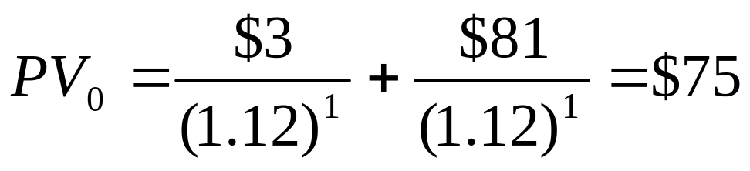
Stock Valuation Example
You expect to receive a $3 dividend and then sell the stock for $81 in one year. What is the stock’s value if the required rate of return (i.e., discount rate) is 12%?
Notes:
Understanding Media: Extensions of Man, published in 1964.
The medium you use to send a particular message automatically predisposes audience members to make certain tacit assumptions about the message before they even read it.
Put another way, people unconsciously judge books by their covers.
How does this apply to business communications?
If you want to announce cutbacks in your company’s health benefits, don’t deliver the message with a glitzy, over-the-top, no-expenses-spared campaign.
Conversely, if you want to position your company as a leader in innovation, don’t advertise your message on sandwich boards dangling from the necks of ragamuffins traipsing around in front of gas stations.

Slide 8
Different Holding Periods
In reality, different investors will have different holding periods
Example: While you expect to hold the previous stock for 1 year, another investor may hold it for 2 years, collecting 2 dividends and selling the stock at the end of year 2
The two of you will have different cash flow streams
Notes:
Understanding Media: Extensions of Man, published in 1964.
The medium you use to send a particular message automatically predisposes audience members to make certain tacit assumptions about the message before they even read it.
Put another way, people unconsciously judge books by their covers.
How does this apply to business communications?
If you want to announce cutbacks in your company’s health benefits, don’t deliver the message with a glitzy, over-the-top, no-expenses-spared campaign.
Conversely, if you want to position your company as a leader in innovation, don’t advertise your message on sandwich boards dangling from the necks of ragamuffins traipsing around in front of gas stations.

Slide 9
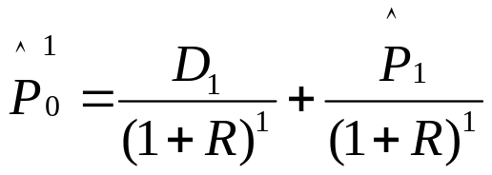
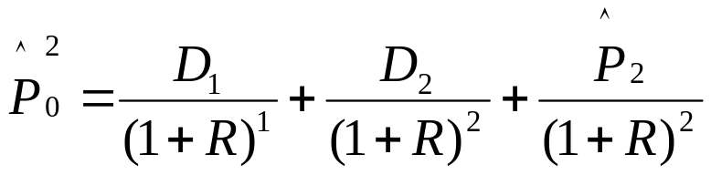
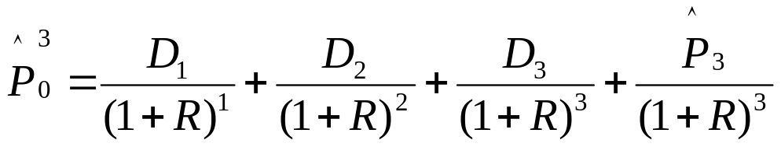
Different Holding Periods continued…
1-year holding period:
2-year holding period
3-year holding period
Which value is correct?
Notes:
Understanding Media: Extensions of Man, published in 1964.
The medium you use to send a particular message automatically predisposes audience members to make certain tacit assumptions about the message before they even read it.
Put another way, people unconsciously judge books by their covers.
How does this apply to business communications?
If you want to announce cutbacks in your company’s health benefits, don’t deliver the message with a glitzy, over-the-top, no-expenses-spared campaign.
Conversely, if you want to position your company as a leader in innovation, don’t advertise your message on sandwich boards dangling from the necks of ragamuffins traipsing around in front of gas stations.

Slide 10
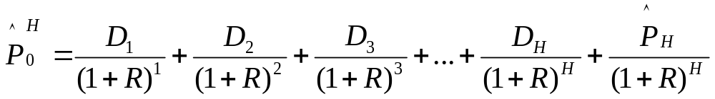
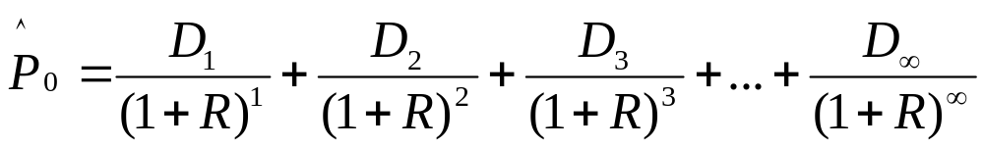
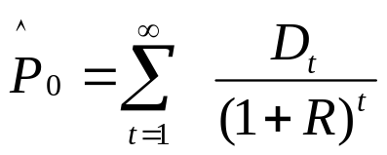
A General Case
For investor with holding period H:
What happens to the PV of the terminal price (P_{H}) as H tends to infinity?
The Dividend Discount Model (DDM): The price is the present value of all future dividends
Notes:
Understanding Media: Extensions of Man, published in 1964.
The medium you use to send a particular message automatically predisposes audience members to make certain tacit assumptions about the message before they even read it.
Put another way, people unconsciously judge books by their covers.
How does this apply to business communications?
If you want to announce cutbacks in your company’s health benefits, don’t deliver the message with a glitzy, over-the-top, no-expenses-spared campaign.
Conversely, if you want to position your company as a leader in innovation, don’t advertise your message on sandwich boards dangling from the necks of ragamuffins traipsing around in front of gas stations.

Slide 11
Special Cases
The dividend discount model should hold in all cases
For illustration, we will consider some very simple special cases
  Expected future dividends are constant (i.e., zero-growth)
  Expected future dividends grow at a constant rate (i.e., constant growth)
Note: Special cases considered are admittedly unrealistic, but useful for pedagogical purposes
Notes:
Understanding Media: Extensions of Man, published in 1964.
The medium you use to send a particular message automatically predisposes audience members to make certain tacit assumptions about the message before they even read it.
Put another way, people unconsciously judge books by their covers.
How does this apply to business communications?
If you want to announce cutbacks in your company’s health benefits, don’t deliver the message with a glitzy, over-the-top, no-expenses-spared campaign.
Conversely, if you want to position your company as a leader in innovation, don’t advertise your message on sandwich boards dangling from the necks of ragamuffins traipsing around in front of gas stations.

Slide 12
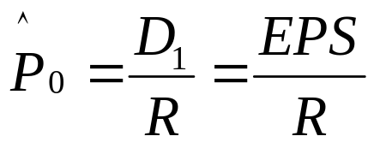
DDM with Zero-Growth
Dividends are constant
Earnings (EPS) are constant as well
  There is no need to reinvest money in the firm
  Pay out all earnings to investors (i.e., D = EPS)
Stock becomes a perpetuity
Example: Consider a firm that earns $25 per share, pays out everything to investors, and the required rate of return (i.e., discount rate) is 8%
Notes:
Understanding Media: Extensions of Man, published in 1964.
The medium you use to send a particular message automatically predisposes audience members to make certain tacit assumptions about the message before they even read it.
Put another way, people unconsciously judge books by their covers.
How does this apply to business communications?
If you want to announce cutbacks in your company’s health benefits, don’t deliver the message with a glitzy, over-the-top, no-expenses-spared campaign.
Conversely, if you want to position your company as a leader in innovation, don’t advertise your message on sandwich boards dangling from the necks of ragamuffins traipsing around in front of gas stations.

Slide 13
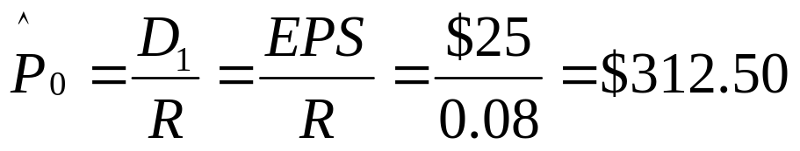
DDM with Zero-Growth
Example: Consider a firm that earns $25 per share, pays out everything to investors, and the required rate of return (i.e., discount rate) is 8%
Notes:
Understanding Media: Extensions of Man, published in 1964.
The medium you use to send a particular message automatically predisposes audience members to make certain tacit assumptions about the message before they even read it.
Put another way, people unconsciously judge books by their covers.
How does this apply to business communications?
If you want to announce cutbacks in your company’s health benefits, don’t deliver the message with a glitzy, over-the-top, no-expenses-spared campaign.
Conversely, if you want to position your company as a leader in innovation, don’t advertise your message on sandwich boards dangling from the necks of ragamuffins traipsing around in front of gas stations.

Slide 14
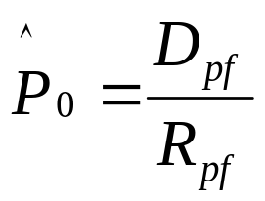
Preferred Stock = Zero-Growth
Hybrid: A little like bonds and a little like common stock
Preferred dividend typically a fixed payment
  Remember Cox Oil Company, Inc.’s preferred dividend of $5.83?!?
So, preferred stock is a perpetuity
But some preferred stocks have finite lives, with many of these types having a 50 year maturity
No problem! Find the PV of a 50 year annuity!!
Notes:
Understanding Media: Extensions of Man, published in 1964.
The medium you use to send a particular message automatically predisposes audience members to make certain tacit assumptions about the message before they even read it.
Put another way, people unconsciously judge books by their covers.
How does this apply to business communications?
If you want to announce cutbacks in your company’s health benefits, don’t deliver the message with a glitzy, over-the-top, no-expenses-spared campaign.
Conversely, if you want to position your company as a leader in innovation, don’t advertise your message on sandwich boards dangling from the necks of ragamuffins traipsing around in front of gas stations.

Slide 15
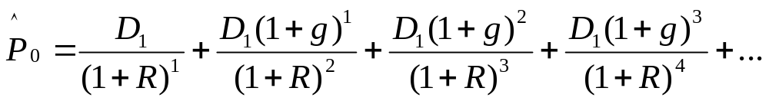
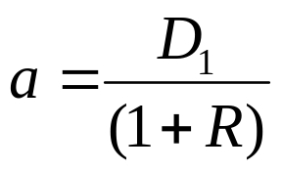
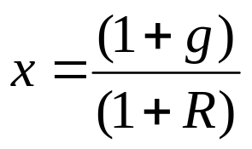
DDM with Constant Growth
Suppose dividends grow at a constant rate (g)
The above is a power series with
and
Notes:
Understanding Media: Extensions of Man, published in 1964.
The medium you use to send a particular message automatically predisposes audience members to make certain tacit assumptions about the message before they even read it.
Put another way, people unconsciously judge books by their covers.
How does this apply to business communications?
If you want to announce cutbacks in your company’s health benefits, don’t deliver the message with a glitzy, over-the-top, no-expenses-spared campaign.
Conversely, if you want to position your company as a leader in innovation, don’t advertise your message on sandwich boards dangling from the necks of ragamuffins traipsing around in front of gas stations.

Slide 16
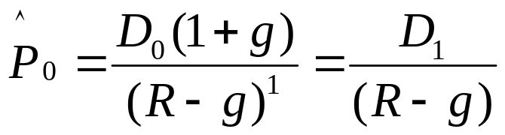
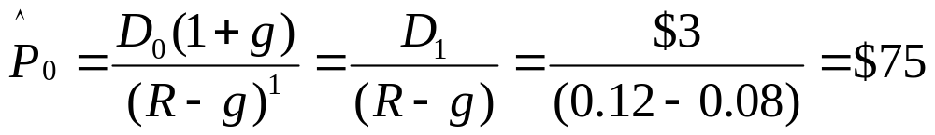
Constant Growth (Gordon) Model
The previous expression simplifies to:
Example: Suppose next year’s dividend is $3, the growth rate is 8%, and the required rate of return is 12%:
Notes:
Understanding Media: Extensions of Man, published in 1964.
The medium you use to send a particular message automatically predisposes audience members to make certain tacit assumptions about the message before they even read it.
Put another way, people unconsciously judge books by their covers.
How does this apply to business communications?
If you want to announce cutbacks in your company’s health benefits, don’t deliver the message with a glitzy, over-the-top, no-expenses-spared campaign.
Conversely, if you want to position your company as a leader in innovation, don’t advertise your message on sandwich boards dangling from the necks of ragamuffins traipsing around in front of gas stations.

Slide 17
The Growth Rate
Basic idea: Firm retains some of its earnings and reinvests to ultimately generate higher future earnings
Plowback ratio (pbr)
  pbr = % of earnings that is reinvested
  Or
  pbr = 1-dividend ratio
  Earnings growth = ROE x pbr
  If dividends are a constant fraction of earnings, then the growth rate for dividends is the same as the growth rate for earnings
Notes:
Understanding Media: Extensions of Man, published in 1964.
The medium you use to send a particular message automatically predisposes audience members to make certain tacit assumptions about the message before they even read it.
Put another way, people unconsciously judge books by their covers.
How does this apply to business communications?
If you want to announce cutbacks in your company’s health benefits, don’t deliver the message with a glitzy, over-the-top, no-expenses-spared campaign.
Conversely, if you want to position your company as a leader in innovation, don’t advertise your message on sandwich boards dangling from the necks of ragamuffins traipsing around in front of gas stations.

Slide 18
The Value of Growth Opportunities
Break stock price into two components
  (1) Value of a zero-growth stock: Firm is a perpetuity
    P_{zero-growth} = EPS/R
  (2) Growth opportunities:
    P – P_{zero-growth}
Note: Growth opportunities should also be reflected in the PE ratio
Notes:
Understanding Media: Extensions of Man, published in 1964.
The medium you use to send a particular message automatically predisposes audience members to make certain tacit assumptions about the message before they even read it.
Put another way, people unconsciously judge books by their covers.
How does this apply to business communications?
If you want to announce cutbacks in your company’s health benefits, don’t deliver the message with a glitzy, over-the-top, no-expenses-spared campaign.
Conversely, if you want to position your company as a leader in innovation, don’t advertise your message on sandwich boards dangling from the necks of ragamuffins traipsing around in front of gas stations.

Slide 19
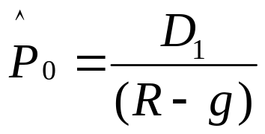
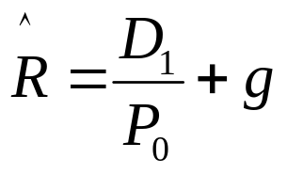
Expected Rate of Return on a Constant Growth Stock
We can algebraically rearrange the constant growth equation as such:
Becomes:
Which is the expected dividend yield plus growth
Notes:
Understanding Media: Extensions of Man, published in 1964.
The medium you use to send a particular message automatically predisposes audience members to make certain tacit assumptions about the message before they even read it.
Put another way, people unconsciously judge books by their covers.
How does this apply to business communications?
If you want to announce cutbacks in your company’s health benefits, don’t deliver the message with a glitzy, over-the-top, no-expenses-spared campaign.
Conversely, if you want to position your company as a leader in innovation, don’t advertise your message on sandwich boards dangling from the necks of ragamuffins traipsing around in front of gas stations.

Slide 20
Expected Rate of Return on a Constant Growth Stock
Expected Rate of Return is made up of two components
  (1) D₁/P₀: Expected dividend yield
  (2) g: Expected growth rate or expected capital gains yield
Therefore, for a constant growth stock both of the following conditions must hold…
  (1) The expected dividend yield is a constant
  (2) Dividends are expected to grow at the constant rate, g forever!
Notes:
Understanding Media: Extensions of Man, published in 1964.
The medium you use to send a particular message automatically predisposes audience members to make certain tacit assumptions about the message before they even read it.
Put another way, people unconsciously judge books by their covers.
How does this apply to business communications?
If you want to announce cutbacks in your company’s health benefits, don’t deliver the message with a glitzy, over-the-top, no-expenses-spared campaign.
Conversely, if you want to position your company as a leader in innovation, don’t advertise your message on sandwich boards dangling from the necks of ragamuffins traipsing around in front of gas stations.

Slide 21
Temporary Supernormal Growth
If dividends grow at a supernormal rate for the first T years
  (1) Find the PV of each dividend during the supernormal period
  (2) Find the expected price of the stock at the end of the supernormal growth period by using the Gordon Growth model (i.e., also called DDM) and discount this price back to time 0
  (3) Sum these two components
Note: Two options for finding the price at time T
  Option 1: Use a zero-growth or constant dividend growth formula
  Option 2: Use a market multiple like a PE ratio
Notes:
Understanding Media: Extensions of Man, published in 1964.
The medium you use to send a particular message automatically predisposes audience members to make certain tacit assumptions about the message before they even read it.
Put another way, people unconsciously judge books by their covers.
How does this apply to business communications?
If you want to announce cutbacks in your company’s health benefits, don’t deliver the message with a glitzy, over-the-top, no-expenses-spared campaign.
Conversely, if you want to position your company as a leader in innovation, don’t advertise your message on sandwich boards dangling from the necks of ragamuffins traipsing around in front of gas stations.

Slide 22
Temporary Supernormal Growth: Example
Earnings are expected to be $2, $3, and $4 over the next 3 years
Dividends are expected to be $1, $1.50, and $2 over the next 3 years
Required rate of return is 12%
Option 1: After 3 years, growth rate is expected to be constant at 5%
Option 2: Expected PE ratio is 10
Notes:
Understanding Media: Extensions of Man, published in 1964.
The medium you use to send a particular message automatically predisposes audience members to make certain tacit assumptions about the message before they even read it.
Put another way, people unconsciously judge books by their covers.
How does this apply to business communications?
If you want to announce cutbacks in your company’s health benefits, don’t deliver the message with a glitzy, over-the-top, no-expenses-spared campaign.
Conversely, if you want to position your company as a leader in innovation, don’t advertise your message on sandwich boards dangling from the necks of ragamuffins traipsing around in front of gas stations.

Slide 23
Temporary Supernormal Growth: Example
Option 1
(1) Find PV of dividends during supernormal growth period
(2) Find expected stock price at end of supernormal growth period
(3) Sum the two components
Periods
0
1
2
3
4
…
Cash flows
$1.00
$1.50
$2.00
$2.10
…
$0.89
$1.20
$1.42
$21.35
P₃=$2(1.05)/(0.12-0.05) = $30
$24.86
Notes:
Understanding Media: Extensions of Man, published in 1964.
The medium you use to send a particular message automatically predisposes audience members to make certain tacit assumptions about the message before they even read it.
Put another way, people unconsciously judge books by their covers.
How does this apply to business communications?
If you want to announce cutbacks in your company’s health benefits, don’t deliver the message with a glitzy, over-the-top, no-expenses-spared campaign.
Conversely, if you want to position your company as a leader in innovation, don’t advertise your message on sandwich boards dangling from the necks of ragamuffins traipsing around in front of gas stations.

Slide 24
Temporary Supernormal Growth: Example
Option 2
(1) Find PV of dividends during supernormal growth period
(2) Find PV of expected stock price at end of supernormal growth period
(3) Sum the two components
Periods
0
1
2
3
4
…
Cash flows
$1.00
$1.50
$2.00
$2.10
…
$0.89
$1.20
$1.42
$28.47
P₃=$4x10 = $40
$31.98
Notes:
Understanding Media: Extensions of Man, published in 1964.
The medium you use to send a particular message automatically predisposes audience members to make certain tacit assumptions about the message before they even read it.
Put another way, people unconsciously judge books by their covers.
How does this apply to business communications?
If you want to announce cutbacks in your company’s health benefits, don’t deliver the message with a glitzy, over-the-top, no-expenses-spared campaign.
Conversely, if you want to position your company as a leader in innovation, don’t advertise your message on sandwich boards dangling from the necks of ragamuffins traipsing around in front of gas stations.

Slide 25
Temporary Supernormal Growth: Example
Option 1
Alternatively, we can sum D₃ and P₃ together and discount this sum
It saves us one time value step
Periods
0
1
2
3
4
…
Cash flows
$1.00
$1.50
$2.00
$2.10
…
$0.89
+
$1.20
$30.00
$22.77
$32.00
$24.86
Notes:
Understanding Media: Extensions of Man, published in 1964.
The medium you use to send a particular message automatically predisposes audience members to make certain tacit assumptions about the message before they even read it.
Put another way, people unconsciously judge books by their covers.
How does this apply to business communications?
If you want to announce cutbacks in your company’s health benefits, don’t deliver the message with a glitzy, over-the-top, no-expenses-spared campaign.
Conversely, if you want to position your company as a leader in innovation, don’t advertise your message on sandwich boards dangling from the necks of ragamuffins traipsing around in front of gas stations.

Slide 26
What if a Firm Doesn’t Currently Pay a Dividend?
Question: How do we value the common stock?
Answer: Estimate when the firm will begin paying dividends, the amount of these dividends, and when any supernormal growth period would end, and use the same procedure as before (i.e., find the PV of future CFs)
Notes:
Understanding Media: Extensions of Man, published in 1964.
The medium you use to send a particular message automatically predisposes audience members to make certain tacit assumptions about the message before they even read it.
Put another way, people unconsciously judge books by their covers.
How does this apply to business communications?
If you want to announce cutbacks in your company’s health benefits, don’t deliver the message with a glitzy, over-the-top, no-expenses-spared campaign.
Conversely, if you want to position your company as a leader in innovation, don’t advertise your message on sandwich boards dangling from the necks of ragamuffins traipsing around in front of gas stations.

Slide 27
What if a Firm Doesn’t Plan to Ever Pay a Dividend?
Question: How do we value the common stock?
Another Question: If a firm never plans to provide any cash flows to common stockholders, is there any value to the common stockholder?
Discuss!
Notes:
Understanding Media: Extensions of Man, published in 1964.
The medium you use to send a particular message automatically predisposes audience members to make certain tacit assumptions about the message before they even read it.
Put another way, people unconsciously judge books by their covers.
How does this apply to business communications?
If you want to announce cutbacks in your company’s health benefits, don’t deliver the message with a glitzy, over-the-top, no-expenses-spared campaign.
Conversely, if you want to position your company as a leader in innovation, don’t advertise your message on sandwich boards dangling from the necks of ragamuffins traipsing around in front of gas stations.

Slide 28
What if a Firm Doesn’t Plan to Ever Pay a Dividend?
Question: How do we value the common stock?
Alternatives to using dividends per share are using EPS or CF per share
A third alternative is using the P/E Multiple approach
Notes:
Understanding Media: Extensions of Man, published in 1964.
The medium you use to send a particular message automatically predisposes audience members to make certain tacit assumptions about the message before they even read it.
Put another way, people unconsciously judge books by their covers.
How does this apply to business communications?
If you want to announce cutbacks in your company’s health benefits, don’t deliver the message with a glitzy, over-the-top, no-expenses-spared campaign.
Conversely, if you want to position your company as a leader in innovation, don’t advertise your message on sandwich boards dangling from the necks of ragamuffins traipsing around in front of gas stations.

Slide 29
Valuing the Entire Corporation
Some applications require us to value an entire firm instead of a share of stock (think mergers)
Concepts are the same
  Do the same analysis using total dividends instead of dividends per share
  You could also value one share and multiply by the number of shares outstanding
Notes:
Understanding Media: Extensions of Man, published in 1964.
The medium you use to send a particular message automatically predisposes audience members to make certain tacit assumptions about the message before they even read it.
Put another way, people unconsciously judge books by their covers.
How does this apply to business communications?
If you want to announce cutbacks in your company’s health benefits, don’t deliver the message with a glitzy, over-the-top, no-expenses-spared campaign.
Conversely, if you want to position your company as a leader in innovation, don’t advertise your message on sandwich boards dangling from the necks of ragamuffins traipsing around in front of gas stations.

Slide 30
Valuing Stocks in Reality
All examples given here are very simple
  Goal is not to provide a sure-fire way to value any stock
  Rather, it is to provide intuition for how stocks should be valued
Two reasons stocks are difficult to value
  (1) In practice, it is very difficult to estimate all future cash flows
  (2) It is also hard to determine an appropriate discount rate
Notes:
Understanding Media: Extensions of Man, published in 1964.
The medium you use to send a particular message automatically predisposes audience members to make certain tacit assumptions about the message before they even read it.
Put another way, people unconsciously judge books by their covers.
How does this apply to business communications?
If you want to announce cutbacks in your company’s health benefits, don’t deliver the message with a glitzy, over-the-top, no-expenses-spared campaign.
Conversely, if you want to position your company as a leader in innovation, don’t advertise your message on sandwich boards dangling from the necks of ragamuffins traipsing around in front of gas stations.

Slide 31
Market Prices are Observable!
If we take market prices as given, we can use expected future cash flows to solve for the discount rate
  We can call this the expected rate of return since it’s based on expected cash flows
  We can call this the required rate of return since it’s determined by investors
Important note: Solving for r this way is different from determining what return investors should require!
Notes:
Understanding Media: Extensions of Man, published in 1964.
The medium you use to send a particular message automatically predisposes audience members to make certain tacit assumptions about the message before they even read it.
Put another way, people unconsciously judge books by their covers.
How does this apply to business communications?
If you want to announce cutbacks in your company’s health benefits, don’t deliver the message with a glitzy, over-the-top, no-expenses-spared campaign.
Conversely, if you want to position your company as a leader in innovation, don’t advertise your message on sandwich boards dangling from the necks of ragamuffins traipsing around in front of gas stations.

Slide 32
Thank you
Thank You!
Charles B. (Chip) Ruscher, PhD
Department of Finance and Business Economics

